Slide 1
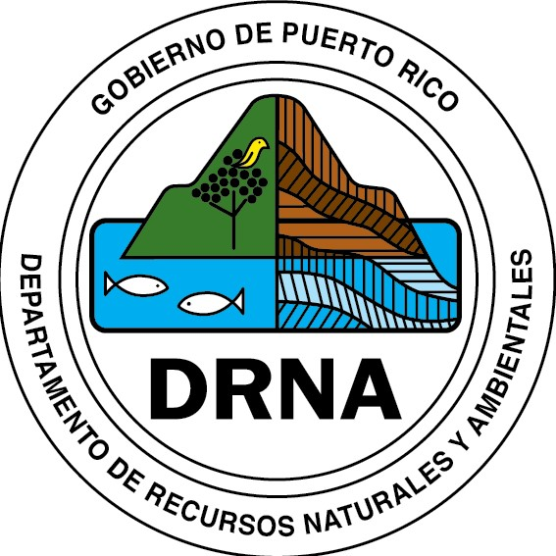
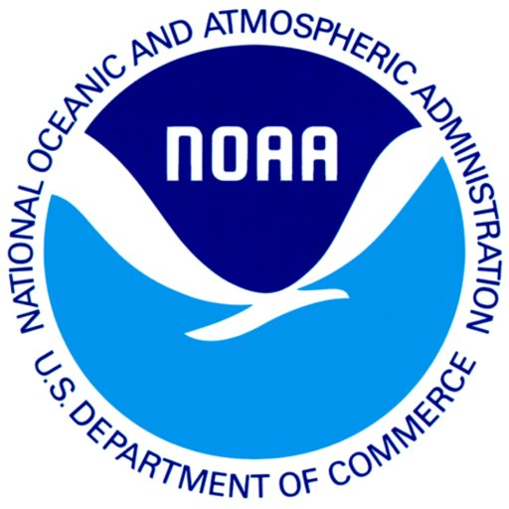
Development of a Vulnerability Self-Assessment Toolkit for Coastal Communities
Presented by Amanda Leinberger
PRCCC Annual Summit
April 7, 2017

Slide 2
NOAA Coastal Management Fellowship
Background
Projects
Timeline

Slide 3
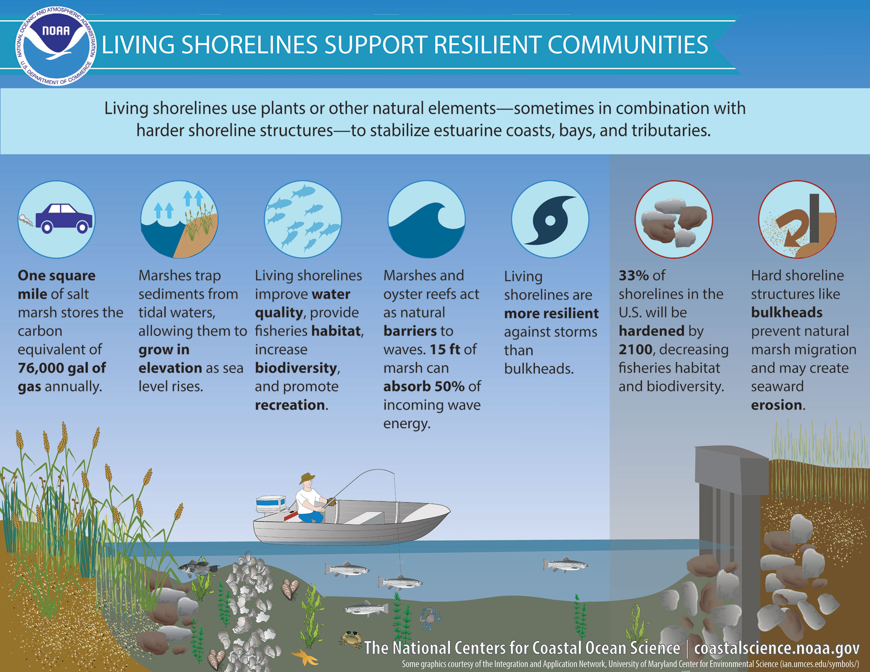
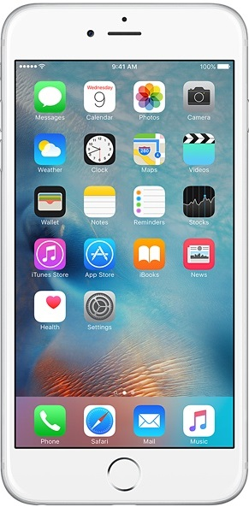
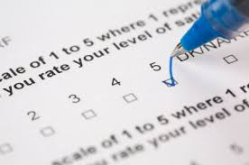
Vulnerability Self-Assessment Toolkit
Introduction to the toolkit
Objectives
Contents
Updated website

Slide 4
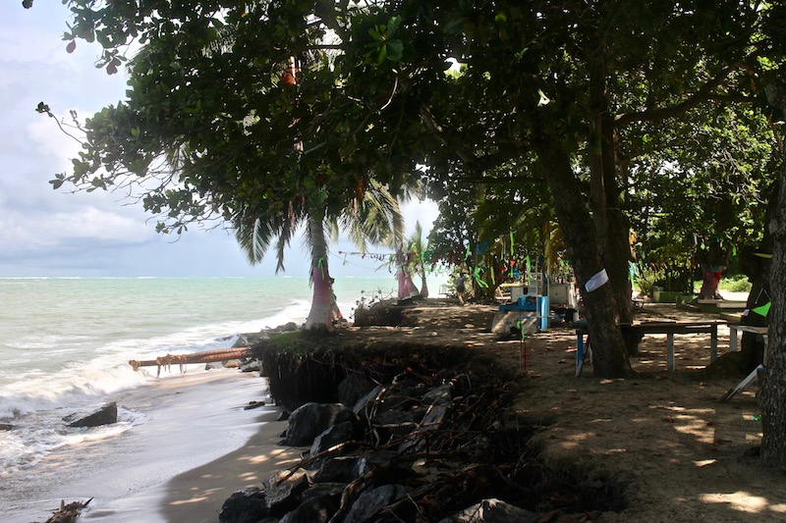
Vulnerability Self-Assessment Tool for Coastal Communities
Introduction to the tool
Objectives and intended audience
Current status of this work
Next steps and timeline
Source: J. Cantieri 2016

Slide 5
Opportunities in this project
Partnerships
Results from related projects could be incorporated into this work
State of the Climate 2014-2017 Report
Integration of this work into WG4 to highlight how we can use self-assessments and other tools to effectively disseminate climate change and hazards information

Slide 6
Thank you!
Request ☺
Contact information:
Email: aleinberger@drna.pr.gov
Phone:
787-999-2200 x2723

