Slide 1


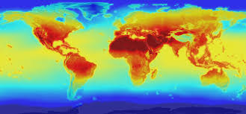




Regional Climate
Model Projections Update
Jared Bowden, University of North Carolina, Chapel Hill, Institute for the Environment
William Gould, US Forest Service, International Institute for Tropical Forestry
Adam Terando, US Geological Service, Southeast Climate Science Center

Slide 2
Existing Complementary Data Sets*
Hayhoe’s statistically downscaled data sets
  Point station resolution
  CMIP 3: predicts drier future
  CMIP 5: aerosols added predicting wetter future
  More GCMs, full century predictions
  Assumes linear and constant meterological behavior from past to future time periods
PRECIS-Caribbean
  50km and 25km resolution
  CMIP 3
SE Climate Science Center dynamically downscaled (focus of this presentation)
* Recommend using the suite of available data sources
Notes:
Net_CDF format can be read by R, terabytes of data. Accessing data similar to working with CMIP data – PIs available to work with next steps

Slide 3
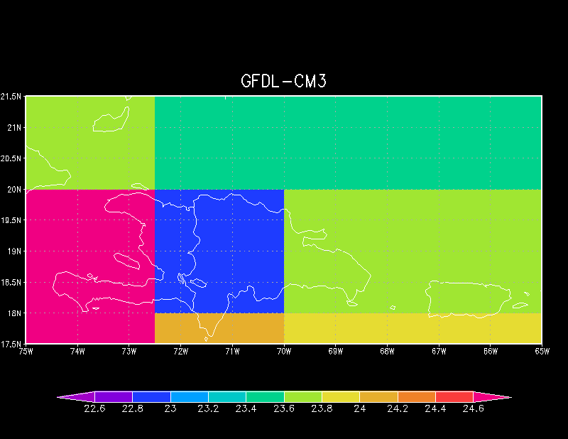
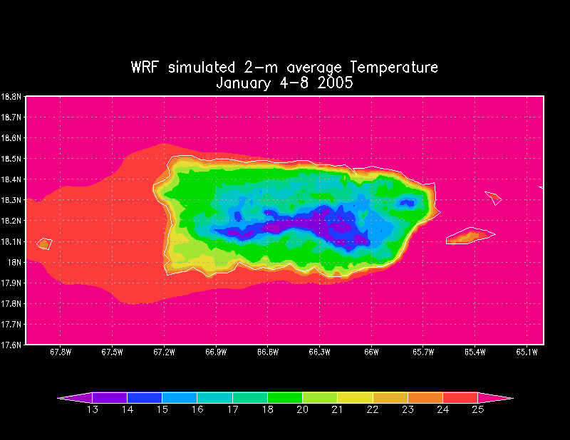
GCM
Downscaled

Slide 4
Experimental Design for Regional Climate Modeling
THREE GCMs
  CCSM4, CNRM5, GFDL-CM3
TWO RCMs
  WRF, NHM-RSM
TWO 20 year periods
  1986-2005 (past)
  2040-2060 (future)
  RCP 8.5 – high fossil fuel emissions scenario
Notes:
GCM = Global Climate Model
RCM = Regional Climate Model
RCP = Representative Concentration Pathway
RCP 8.5 = 8.5 watts/meter^2 of energy added to the system through the combustion of fossil fuels (this is a VERY high emissions scenario and also the one that tracks most closely with our CURRENT EMISSIONS)
WRF (pronounced like “wharf”)…all other acronyms just spelled out

Slide 5
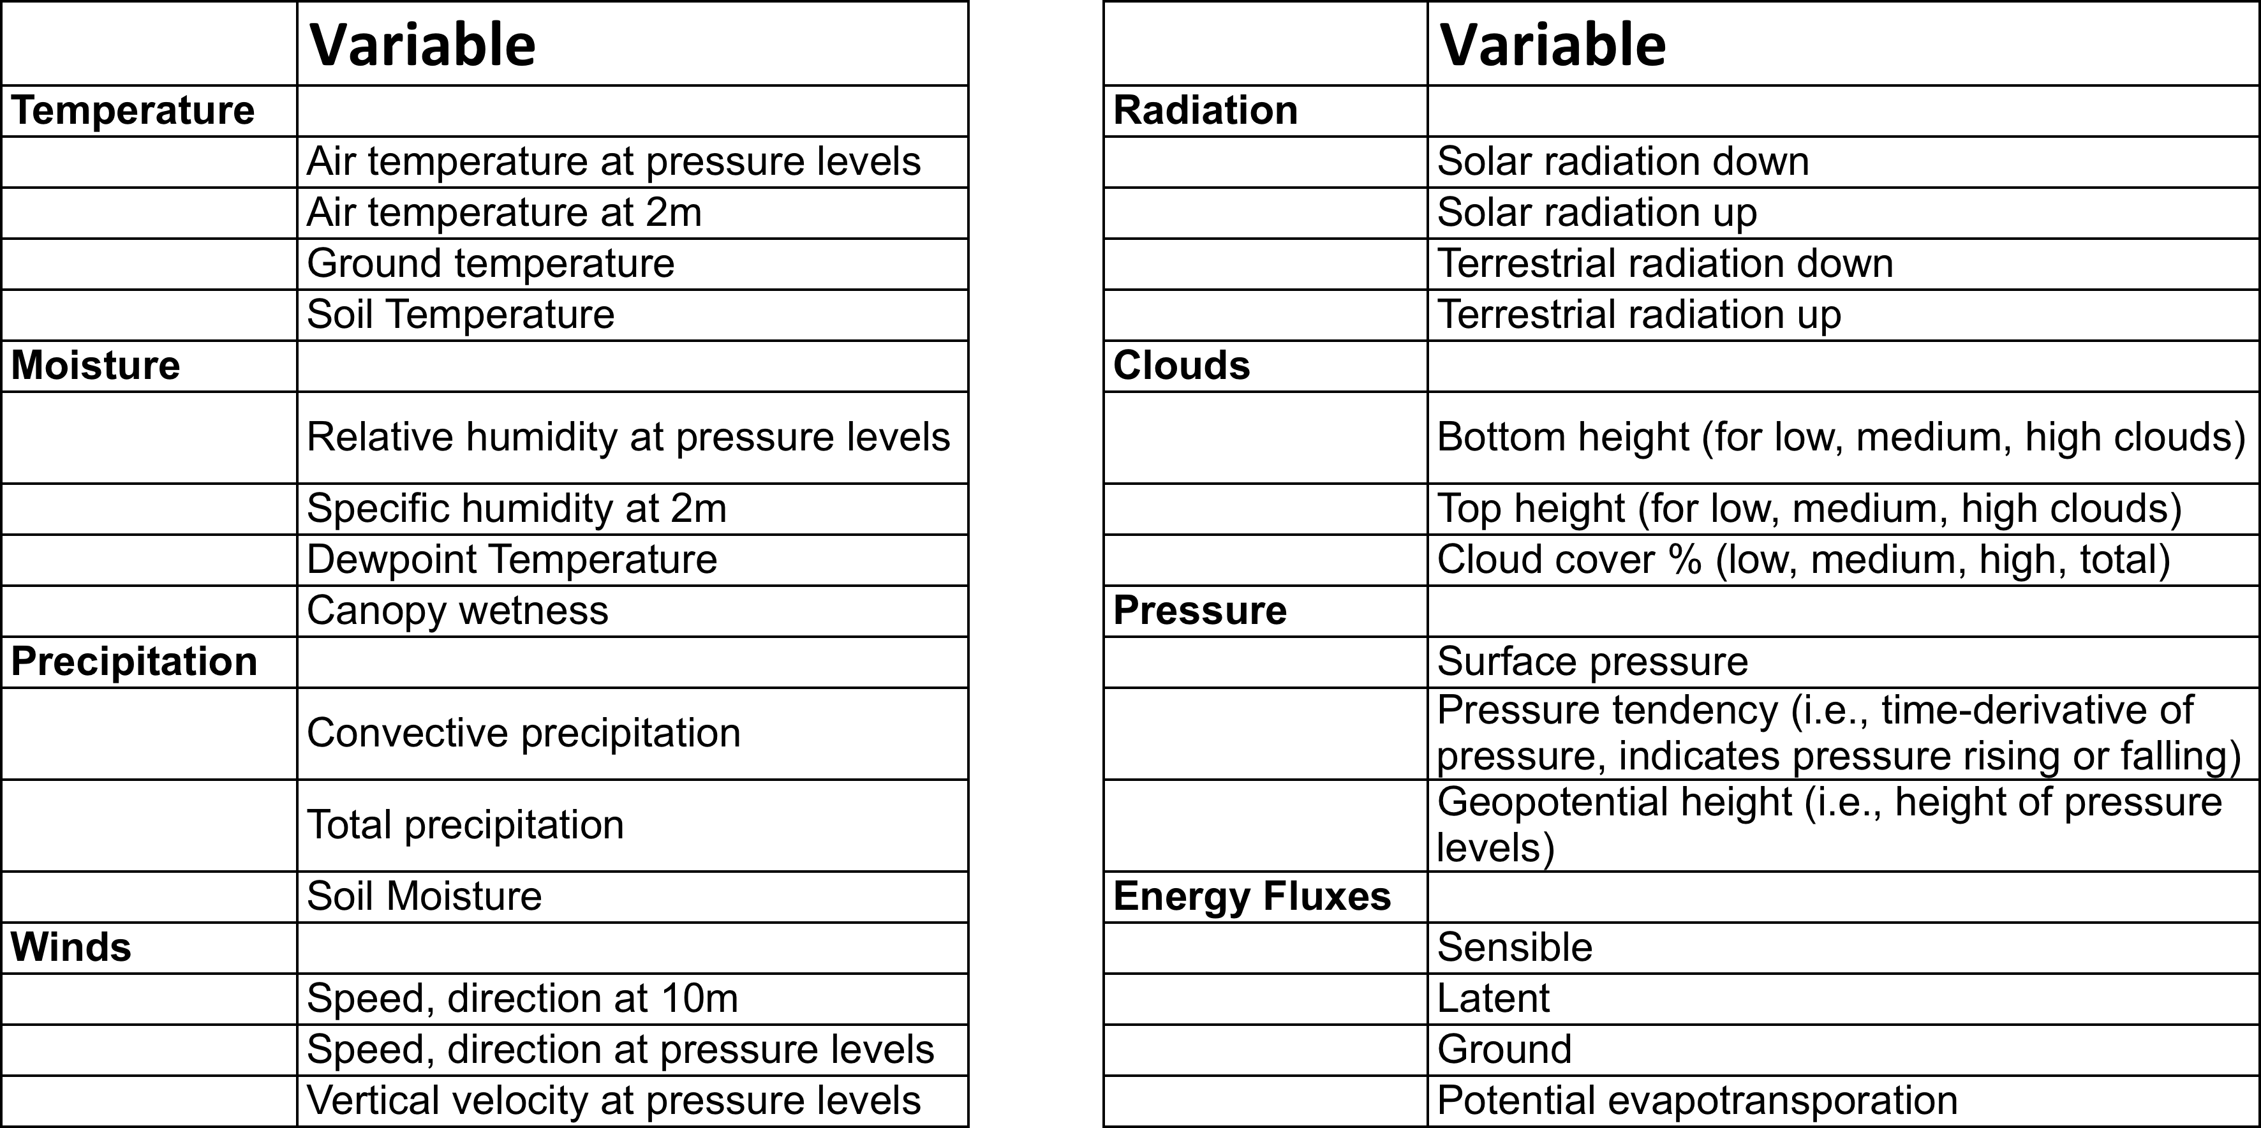
Downscaled Weather Variables

Slide 6
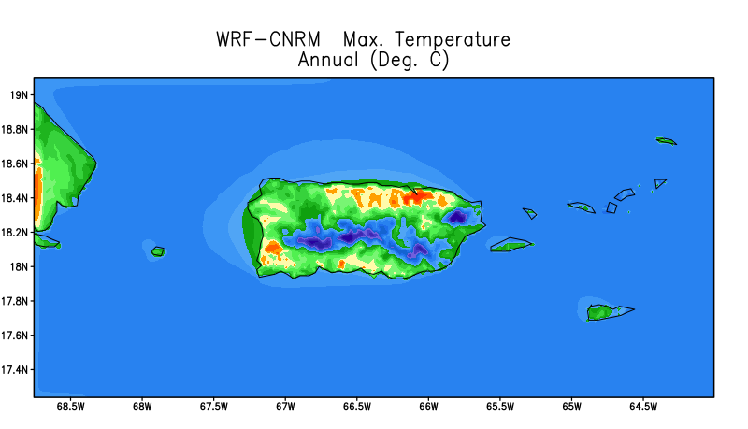
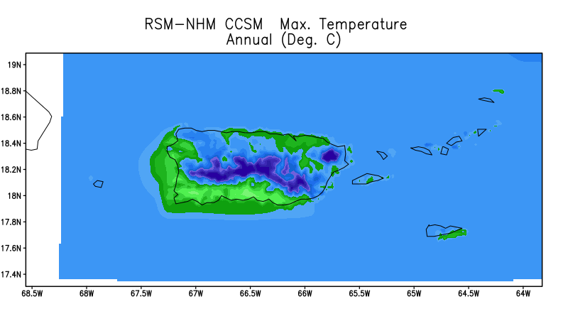
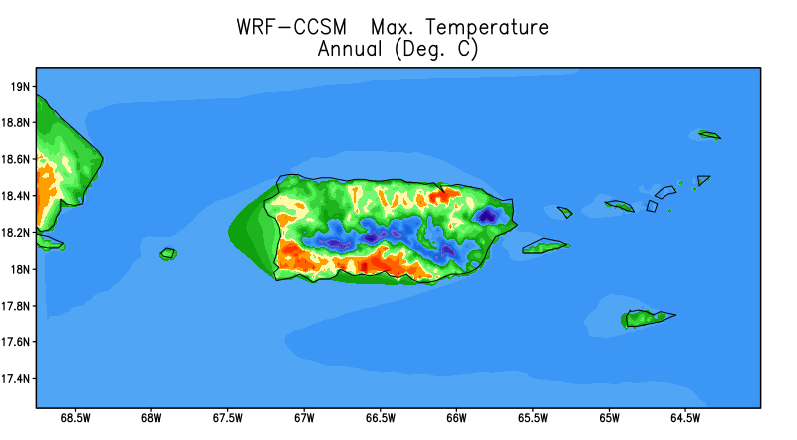
First question to ask :
How well do we simulate the historical climate?
Maximum 2-m Temperature annual average over P.R.
-0.9°C
-2.7°C
-0.5°C

Slide 7
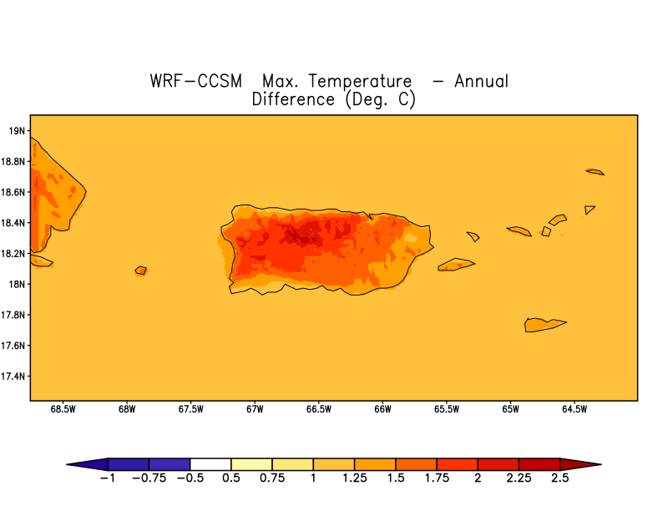
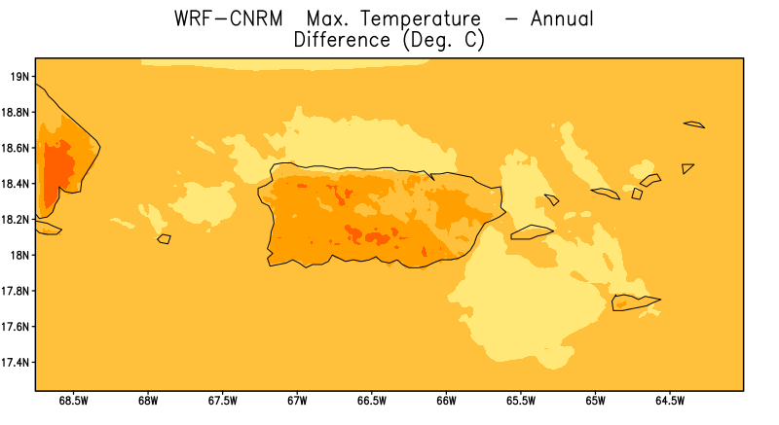
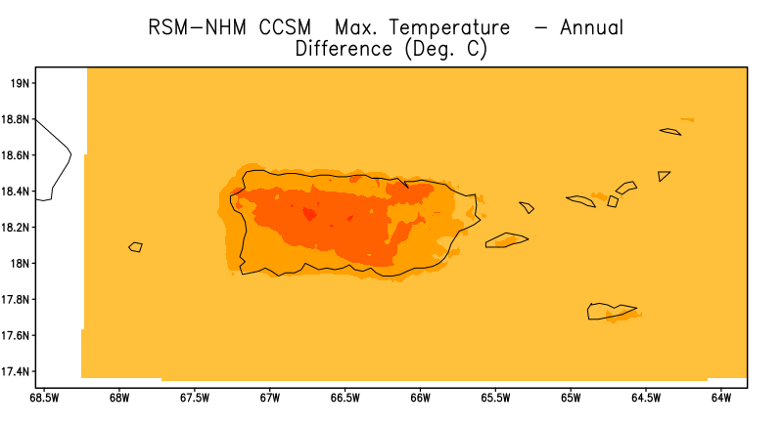
Maximum 2-m Temperature Change
annual average

Slide 8
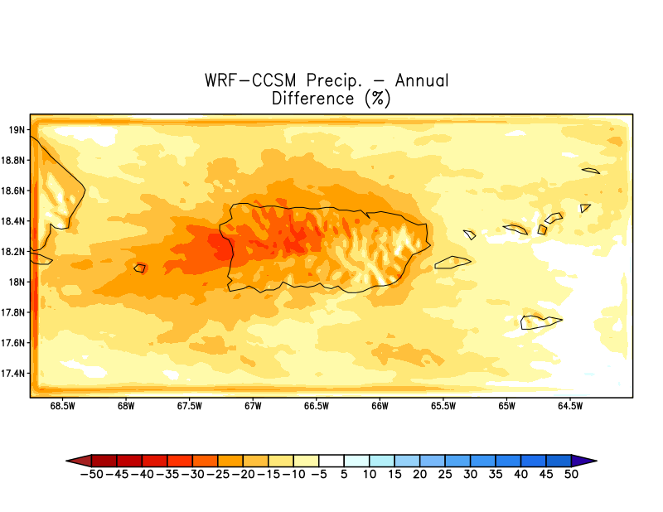
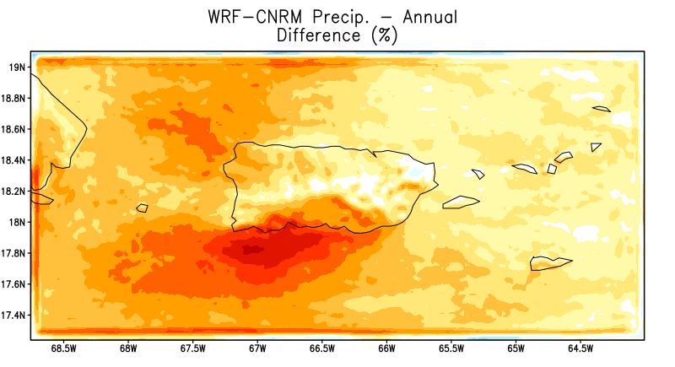
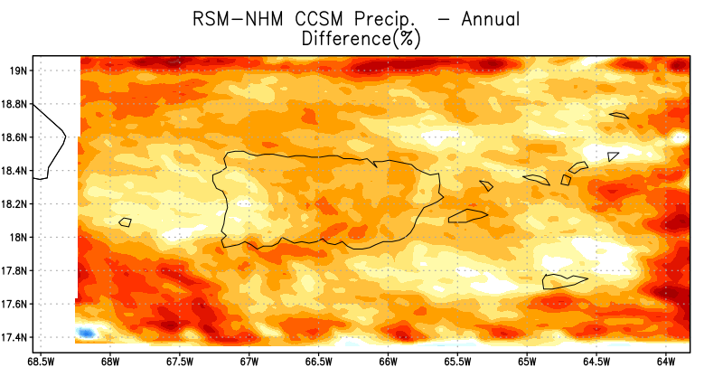
Precipitation Change
percent change for the annual total

Slide 9
Precipitation Change during Wet Season (April-October)
South to North crossing El Yunque Rainforest
Notes:
Note that becomes wetter for one dynamical downscaled projection (WRF in RED) and drier for another (NHM-RSM in BLUE)
Both downscale the same GCM
Here the percent difference is applied to the WORLDCLIM climatology (Black)
Highlights seasonal and regional uncertainty for precipitation

Slide 10
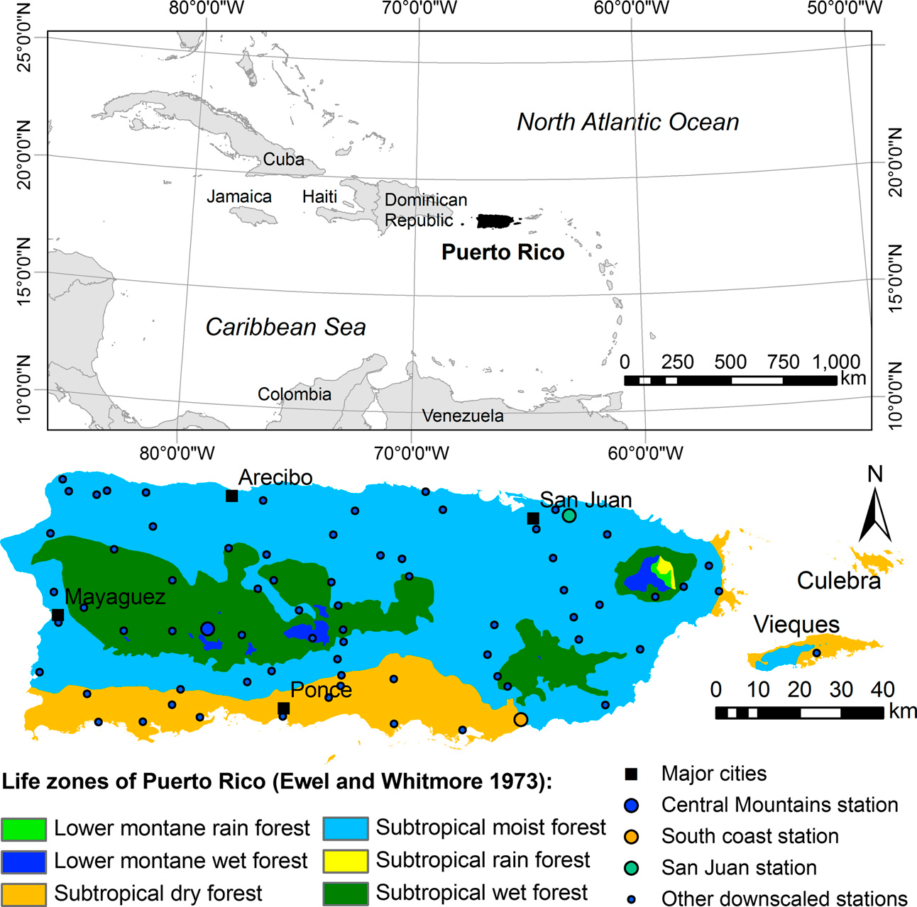
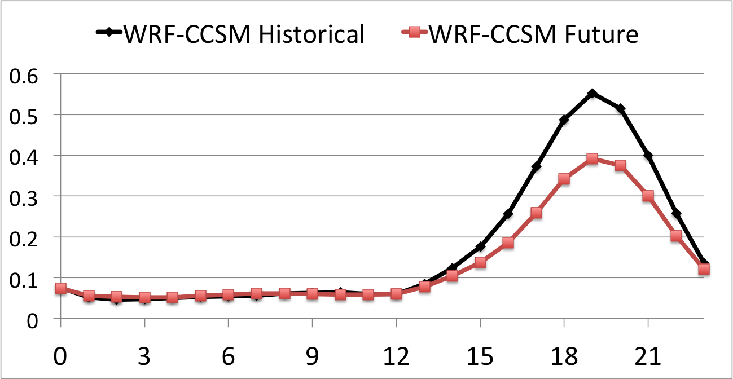
Example of Ongoing Analysis
ECOREGION ANALYSIS - Diurnal Cycle of Precipitation
Subtropical wet forest – Dark Green

Slide 11
Downscaled Weather Variables

