Slide 1


WG2: Ecology and Biodiversity
Freshwater Ecosystems
Sofia Burgos Caraballo, PhD
Comprehensive water plan monitoring division
Department of Natural and Environmental Resources

Slide 2
OUTLINE
Approach used for the freshwater section
The River Continuum Concept
Stressors

Slide 3
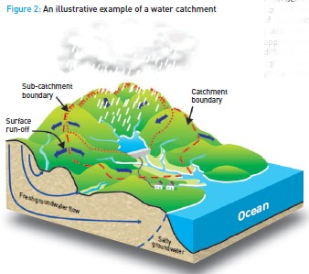
Watershed Approach
Landscape modification
  Urbanization and agriculture
  Elimination of riparian areas
Instream modifications
  Obstructions in the main channel
  Degradation in water quality
  Introduction of exotic species
http://www.nsrwa.org

Slide 4
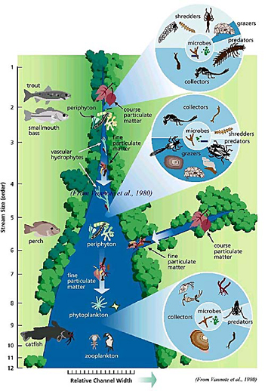
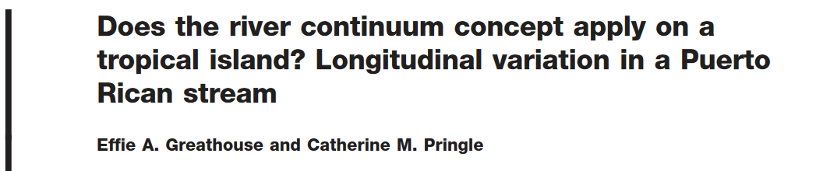
The River Continuum Concept
Vannote et al. 1980

Slide 5
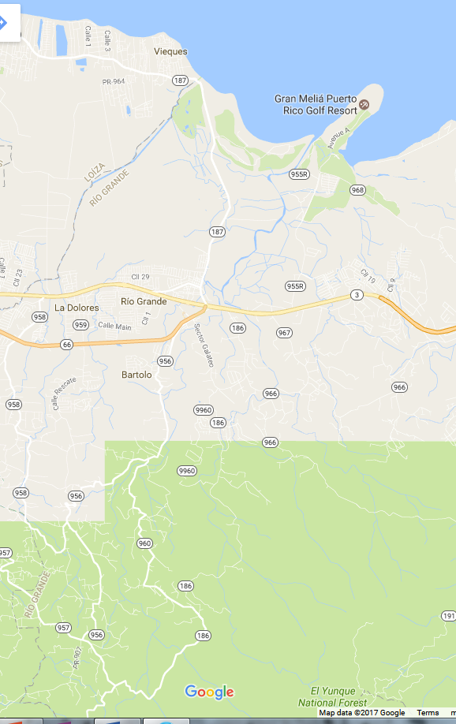
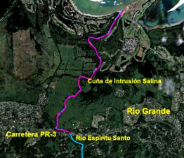
Stressor: Sea Level Rise and
Salt Water Intrusion
During low flow periods there is more salt water intrusion
  Establishment of saline tolerant species that can increase in abundance and outcompete freshwater species.
Gaps:
  How far can it moves upstream?
  What are the implications?
http://www.recursosaguapuertorico.com/Intrusion-Salina.html
Notes:
E.g. Río Espiritu Santo can reach up to PR-3. is more than 2 km upstream.

Slide 6
Stressor: Temperature
Reduce the water capacity to retain dissolved oxygen.
Affect the growth rate and distribution of species.
  Reductions in the size of adults.
  Increases in metabolic rates and nutrient cycling.
Gap:
  What is thermal threshold for freshwater aquatic organisms?

Slide 7
Stressor: Storms and hurricanes
Erosion and sedimentation
  Increase downstream transport of dissolved and particulate material.
  Hurricane-related flooding cause mortality and displacement of fauna (fishes, shrimps, crabs).
Gaps:
  Even when these species can be resilient through the mechanisms of recruitment and recolonization, are these mechanisms sufficient for species subsistence in the face of more frequent and intense storm events?

Slide 8
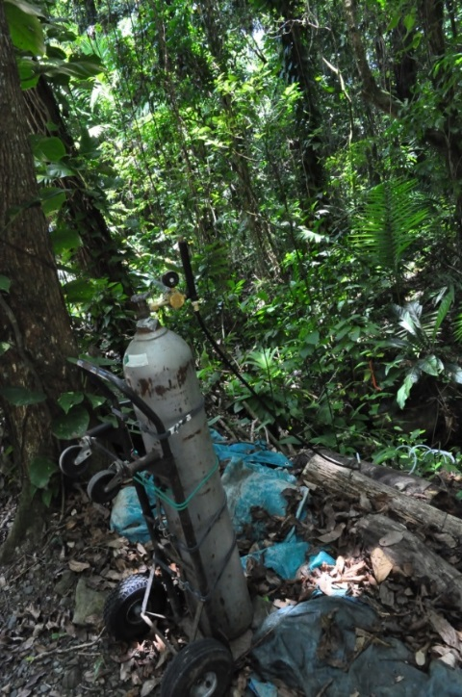
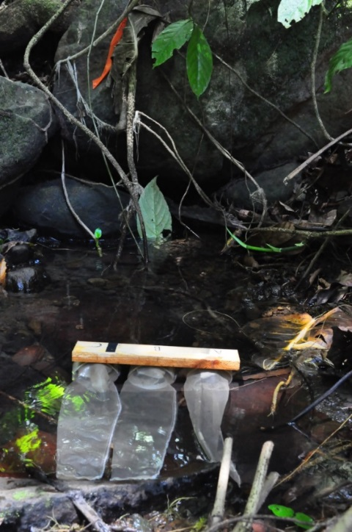
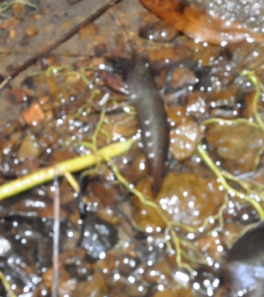
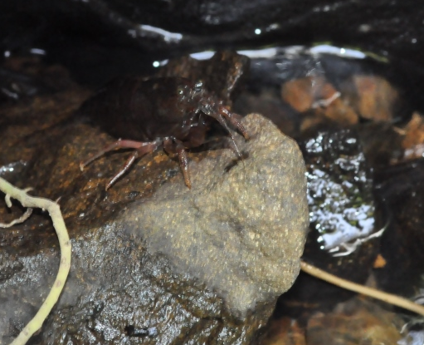
Stressor: CO₂
Indirect CO₂ input
Experimental addition of CO₂ has shown a reduction in stream pH and a negative effect on macroinvertebrates.

Slide 9
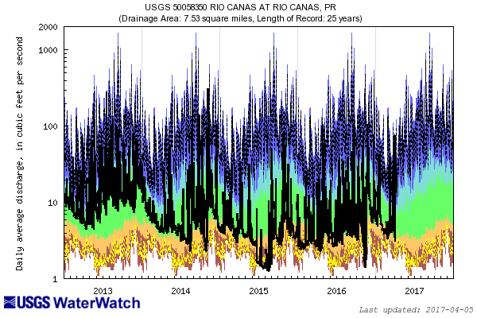
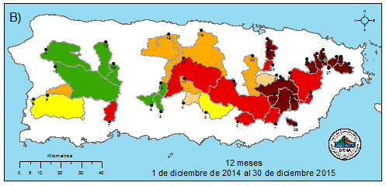
Stressor: Drought
Concentration of pollutants:
  pharmaceutical products (such as antibiotics, analgesics, anti-inflammatory)
  personal care products
  endocrine disruptors (caffeine, aspirin, steroids, hormones, among others).
Persist even after water treatment!
Gap:
  How long it takes to the river to recover the deficit in flow?

Slide 10
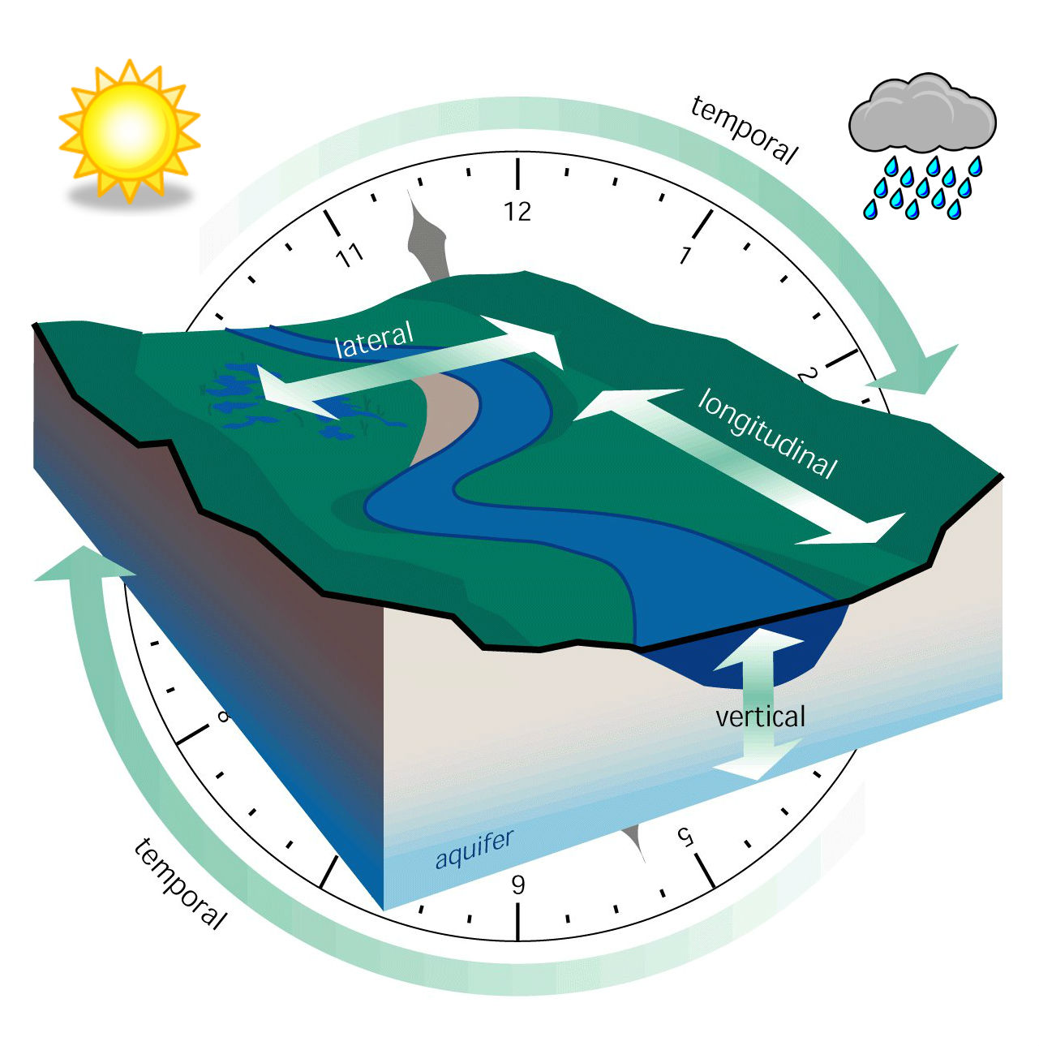
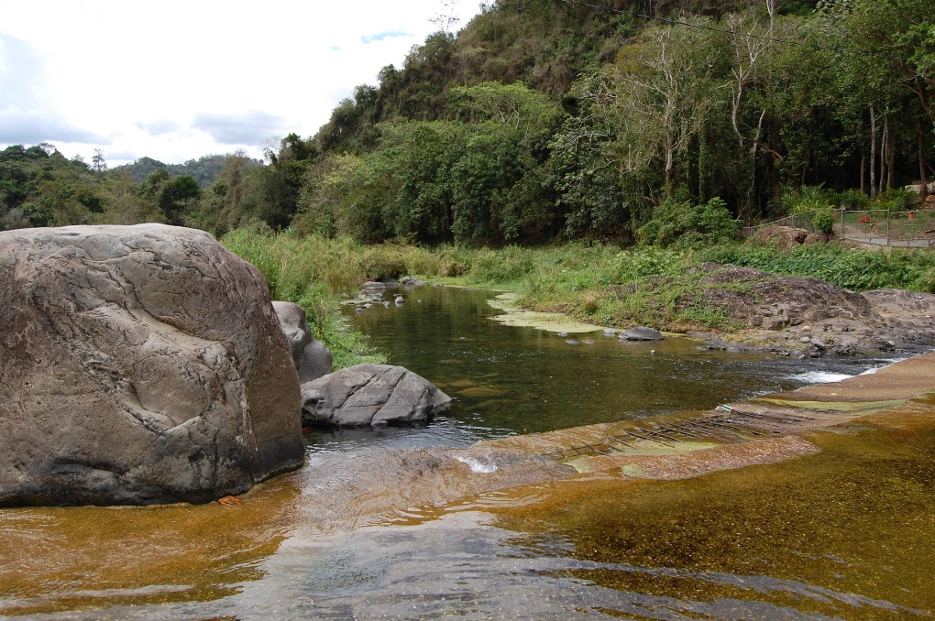
Stressor: Drought
Abundance of exotic fish species
Enhance the effect of barriers
Reduction in connectivity

Slide 11
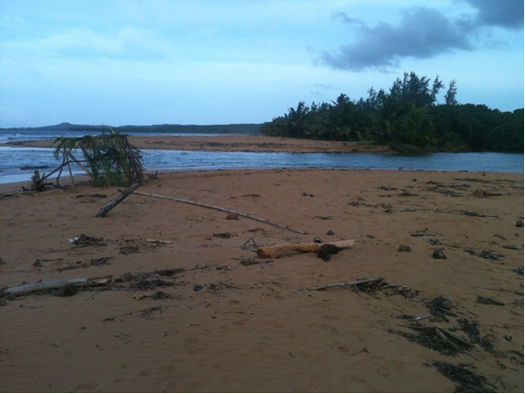
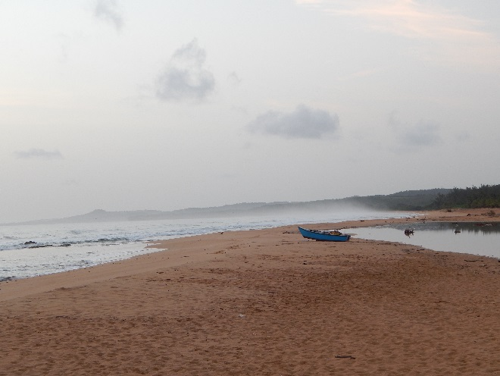
Stressor: Drought
Accumulation of sediments in river mouth
  Restrict the entrance of migratory fauna.
  Nutrients from marine origin will be eliminated.
River mouth of río Sabana, without sand berm (picture taken on May 24, 2014).
River mouth of río Sabana with sand berm formed (picture taken on July 17, 2014).

Slide 12
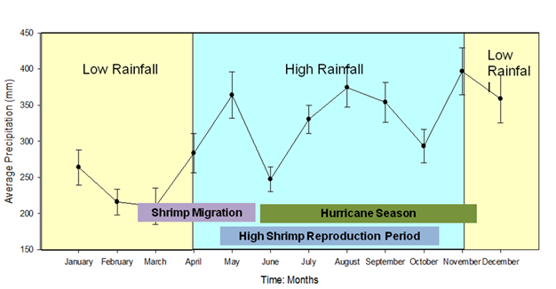
Stressor: Drought
High flow- Reproduction and egg release
Low flow- Migration
Effects of the past two droughts:
  an increased in densities of macroinvertebrates
  downstream migration of filter feeders and shredders;
  an increased in the number of predators (e.g. Macrobrachium) in the headwater pools
Gap:
  What are the effects of prolonged drought events on the migration patterns?

Slide 13
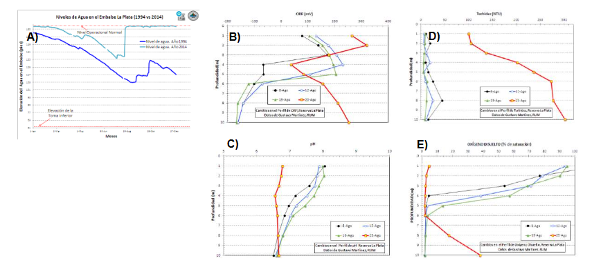
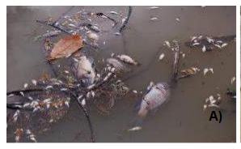
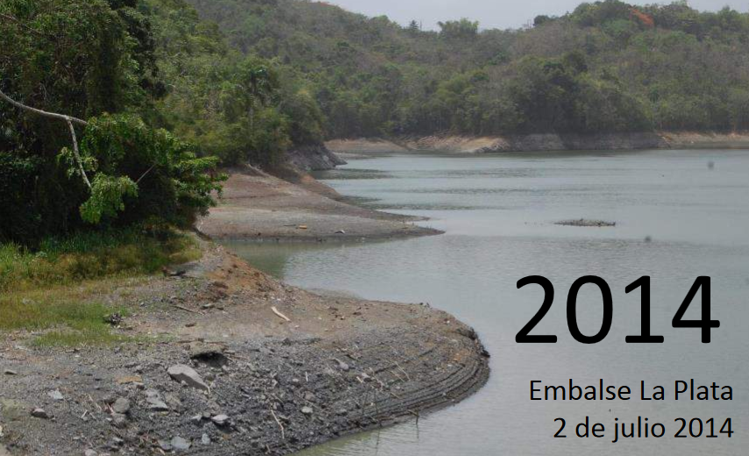
Stressor: Drought
Gaps:
  How long it takes to recover?
  What is the best way to manage reservoirs to prevent future massive death events?

Slide 14
Questions? Suggestions?

