Slide 1

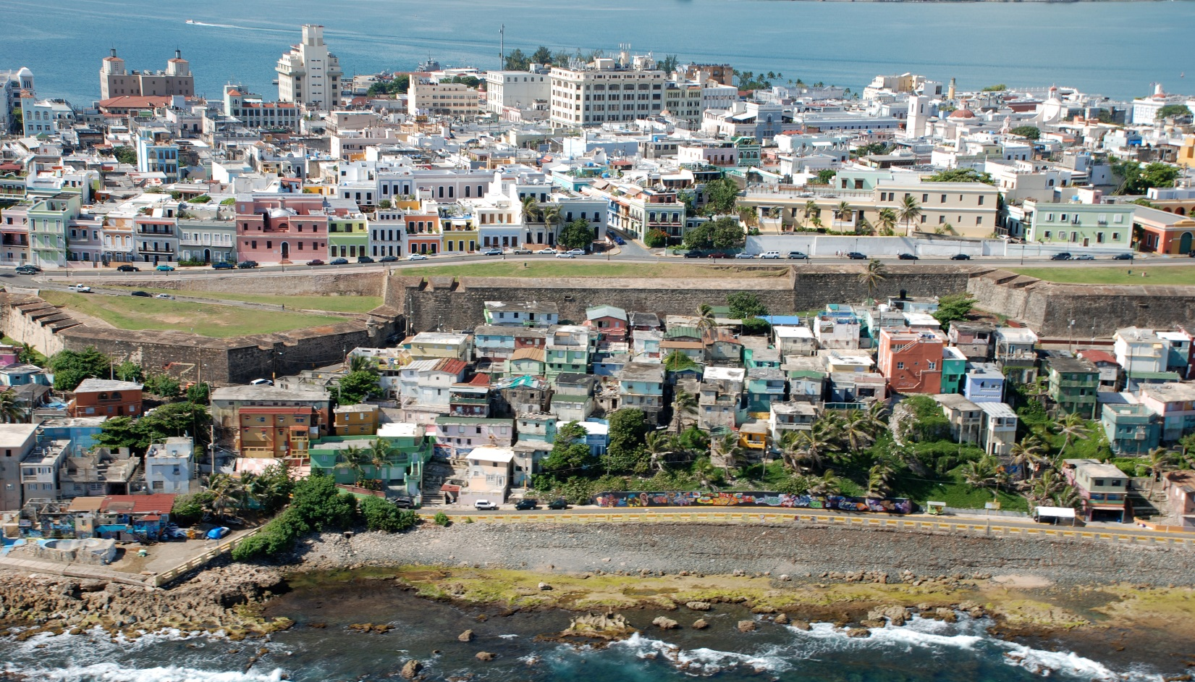
Puerto Rico’s Economy: Background, Current Trends and Climate Change
April 7, 2017

Slide 2
Economic History
Exhaustion of industrial policy based on pharma exports and tax incentives (external changes)
Decade-long economic contraction
  Steady decrease of the quality of life in the island
  Massive loss of jobs
  Outmigration
  Increasing recognition that the institutional framework is obsolete
Real GNP growth has experienced long-term stagnation from fiscal 1975 onwards. Since 2000 two trends have characterized Puerto Rico’s economic performance
  Declining real GNP growth at the beginning of the decade. Economy declining at an average rate of -1.6%. Since fiscal 2007 the economy has contracted since then by -16.4%.
  A widening gap between P.R.’s and the U.S. Between 2000 and 2016; while P.R.’s economy contracted at an average rate of -0.3%, the U.S. economy expanded at an average annual rate of 2.1%.
Notes:
Contraction of Manufacturing and Construction; transition to service economy
Since the onset of the contraction, between fiscal 2007 and February of this year there has been a net loss of 163,642 jobs (Salaried employment), with 52% coming from the private sector, mostly in manufacturing and construction.

Slide 3
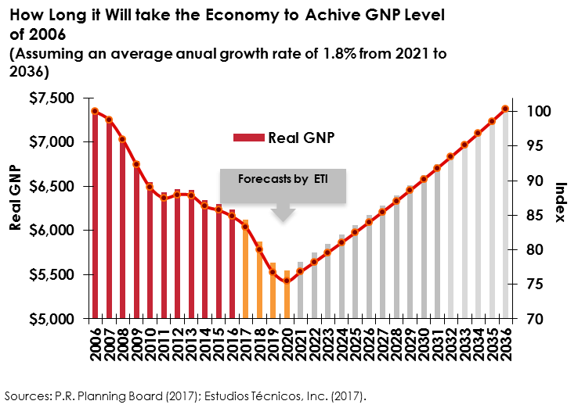
Deep Economic Contraction
Notes:
By 2010, the population showed signs of a profound and accelerated aging process; the population younger than 34 years old has declined by approximately 243,000 individuals, while the population 45 years and over increased by almost the same amount (233,000 individuals). From 2000 to 2014, the median age of the population increased by 6 years and is now 40.
Current fiscal year 2017 is estimated to end with a contraction in real GNP growth of -1.8%, and during the following two years (2018 – 2019) the economy will contract further, an annual average 4.0%, and in fiscal 2020, -1.6%

Slide 4
Employment
Notes:
Under national circumstances this employment loss would had cause substantial disruption. However, migration offset total effects in the Econ

Slide 5
Annual Out-migration
Note: Net out-migration in 2016 is estimated at 65,000.
Notes:
Out of all immigrants, 49% are less than 24 years old.
The probability of a young person migrating is twice that of someone 40 to 54 years old.
Those with some college and bachelor degree are four times more likely to migrate than those with graduate and professionals degrees.
Only 9.9% have graduate or professional degrees, yet they are a large proportion of their respective professions.

Slide 6
Population
  According to the 2016 Community Survey, every municipality lost population between 2010 and 2015 with the exception of Gurabo (3.7%)and Toa Alta (0.1%).
3,808,610
3,725,789
3,678,732
3,634,488
3,593,077
3,534,874
3,473,181
3,411,307
3,254,156
3,133,942
2000
2010
2011
2012
2013
2014
2015
2016
2020
2025
Source: Census Bureau and ETI.
Notes:
Our estimates points toward 2.9 for 2030

Slide 7
Population Pyramids

Slide 8



The Social Dimension
39.9%
46.2%
A population
with an accelerated
rate of aging
Labor participation rate
Families under poverty level
37.7%
+40,000
0.54
Families receiving nutritional assistance
Net migration in recent years
Gini coefficient , the highest level of inequality in the U.S.
Notes:
8
Gini = 0 perfect equality
Gini = 1 perfect inequality
Puerto Rico the highest among US states. i.e. NY .49

Slide 9
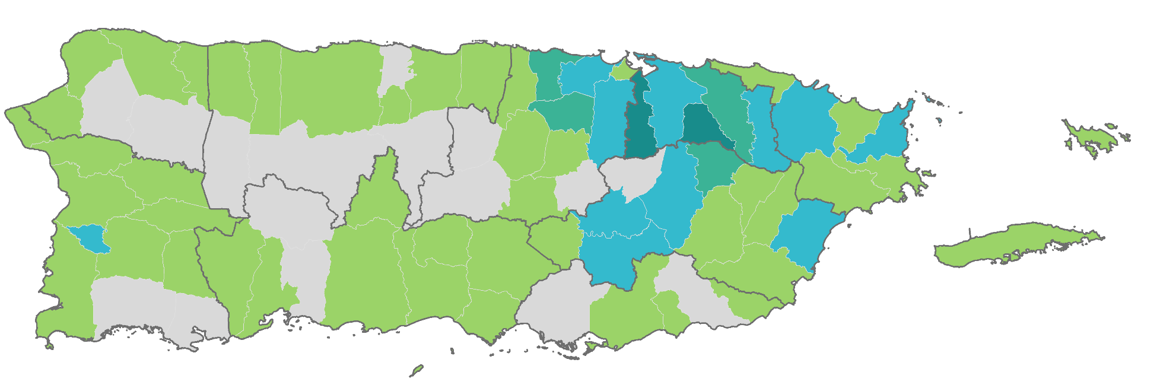
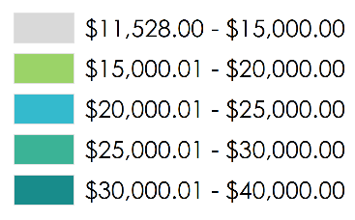
Inequality
Median Household Income by Municipality and Region
Aguadilla: $15,303
Arecibo: $16,646
Bayamón: $22,121
Puerto Rico: $19,624
San Juan: $26,235
Fajardo: $20,257
Median Household Income
Mayagüez: $16,103
Ponce: $16,541
Guayama: $15,868
Source: Encuesta de la Comunidad 2013, Negociado del Censo.
Note: Even in a 100 X 35 mile island, there are wide geographic disparities

Slide 10
Local Governments
Revenue Structure: Municipalities
Under an scenario of economic and social uncertainty, Municipalities will experience a strong pressure from locals
Federal programs are expected to decrease (“skinny budget” $18b program cuts)
i.e. Deep cuts in HUD- CDBG Program 50%
i.e. “Coastal Zone Management Grants (-$70m, eliminated), resilience grants (-$15m, eliminated), and climate grants (-$30m). The cut to climate research grants is consistent with 2017 House marks”
Source: Estados Financieros Auditados 2013 y 2014

Slide 11
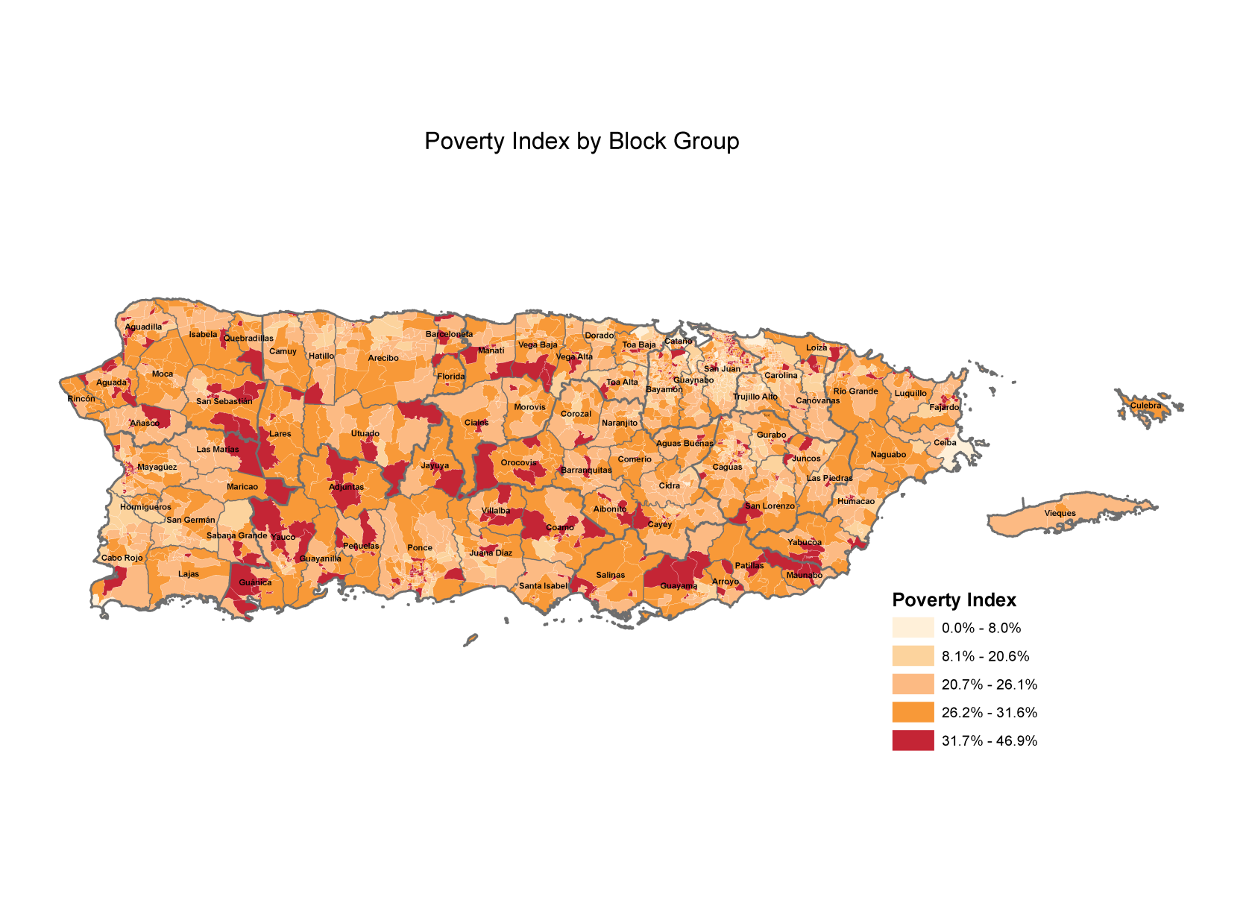
Adaptive Capacity

Slide 12
Adaptive Capacity
14% of all property value in coastal zones are potentially at risk of sea level rise (2m) ($11.8b)*
Total Population in flood zones: 524,469 / Population with no high school diploma in the same areas 94,456 (18%)
Notes:
*2017 CRIM adjusted values
Total $81b
The result for this indicator was of an elevated 69% for home owners and 31% for renters. This means that around 601 thousand homeowners in Puerto Rico could live in conditions of deprivation, even if their income is above the poverty line.

Slide 13
Preliminary Conclusions
Socioeconomic conditions as drivers of adaptive capacity
  Current fiscal contraction with prolonged consequences
  Increased vulnerability from both physical and social variables
  Fertile grounds for profound institutional changes (collaboration) i.e. Fed Funds
  Strategies must consider adequate adaptation policies under current scenarios
Climate change interrelated with economic development
  Adaptation as an opportunity for economic development
  Increased competitiveness
  Visitor economy and short term potential to bootstrap growth
Notes:
Poverty strategy + climate change

Slide 14


¡Gracias!
Lcdo. Kevin González-Toro
kevingonzalez@estudios-tecnicos.com
787-751-1675

